Slide 1
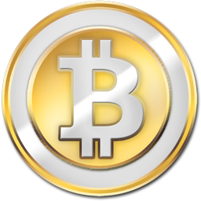
Bitcoin

Slide 2

Hypothesis:
Are global economic factors driving the price of Bitcoin?
Tools:
Pandas, Numpy, Matplotlib, Excel, JMP
Resources:
API from:
SpreadSheet.io for prices and volume
The World Factbook and Quandl for global economic data
Data from coinmarketcap.com,, Bloomberg, bitcoinity.org,

Slide 3
What is Blockchain
created in 2009 by an unknown person/group using the alias Satoshi Nakamoto
What is Bitcoin:
first decentralized digital currency, as the system works without a central bank or single administrator.
Why Bitcoin matters:

Slide 4
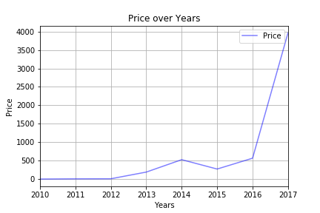
Bitcoin Price over Years

Slide 5
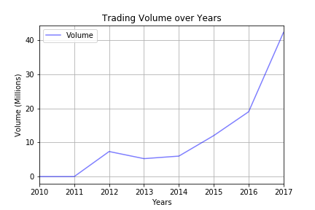
Bitcoin Trading Volume over Years

Slide 6
Traditional Reasons to Invest in Currencies
• Diversification
• Hedge Against Inflation
• Capital Appreciation
Conventional currencies move relative to each other

Slide 7
Diversification: Lots of Players
•1180+ cryptocurrencies with transactions totaling more than $1000 in a recent 24-hour period
•180+ cryptocurrencies with market caps of at least $100,000 USD
•33 cryptocurrencies with market caps over $1 million USD
•5 cryptocurrencies with market caps over $15 billion USD

Slide 8
Diversification: Focus and Niches
•Bitcoin (2009) – The original cryptocurrency
•Ethereum (2015) – Focused on facilitating smart contracts
•Ripple (2017) – Intended to be a cross-border payments solution for large financial institutions
•Bitcoin Cash (2017) – Split from Bitcoin. Focused on reducing transaction times.
•Cardano (2017) – Focused on a more robust, decentralized design process following best practices
Notes:
These are the top 5 cryptocurrencies found in our project research. You can read off this slide and discuss the information in the slide.

Slide 9
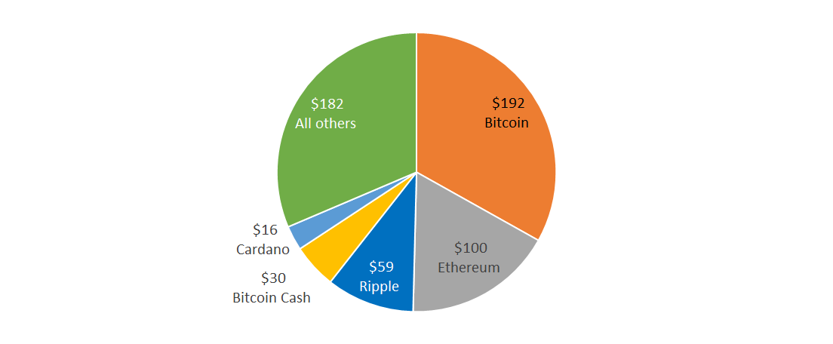
Cryptocurrencies by Market Cap in billions of USD as of 1/19/2018
Notes:
This slide discusses the market cap by crypto. Here focus on the value of each crypto and explaining the value (e.g. Bitcoin market cap value is $192 billion, n so on)

Slide 10
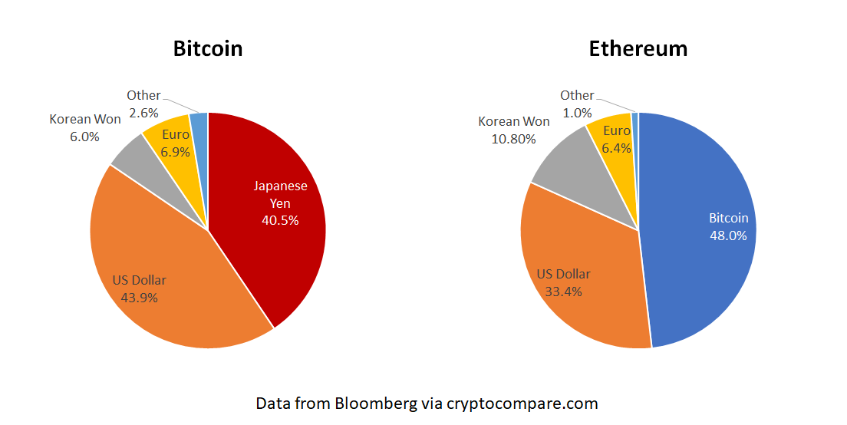
Bitcoin vs Ethereum: Currency Used to Purchase as of 1/9/2018

Slide 11
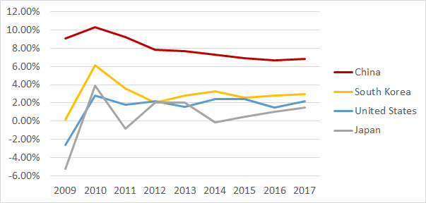
Hedge Against Inflation? Real GDP Growth by Country
Data from The World Fact Book - cia.gov

Slide 12
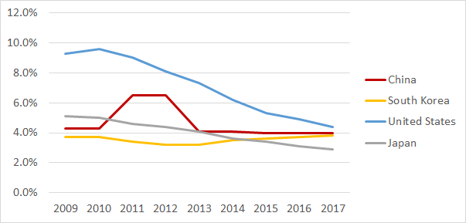
Hedge Against Inflation? Unemployment Rate by Country
Data from The World Fact Book - cia.gov

Slide 13
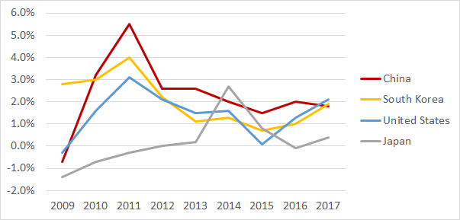
Hedge Against Inflation? Inflation Rate by Country
Data from The World Fact Book - cia.gov

Slide 14
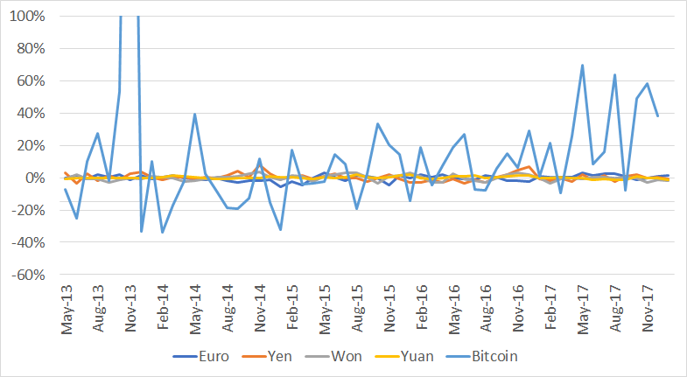
Capital Appreciation?
Relative Changes vs the Prior Month (Compared to the Dollar)
Data from The World Fact Book - cia.gov

Slide 15
Bitcoin Timeline
November, 2013 :
November, 2013 :
October, 2008 : The Year It All Began
Present
February, 2013 :
January, 2013 :
US Senate holds first hearing on the digital currency. Bitcoin skyrockets to $700.
US Senate holds first hearing on the digital currency. Bitcoin skyrockets to $700.
Nakamoto releases his white paper which depicted his idea for a purely peer-to peer version of electronic cash.
Bitcoin hits $1 Million Market Cap
Bitcoin hits $1000 for the 1st in 3 years

Slide 16
4. Closing
Build confidence around your product or idea by including at least one of the these slides:
Milestones What has been accomplished and what might be left to tackle?
Testimonials Who supports your idea (or doesn’t)?
What’s next? How can the audience get involved or find out more?

